Slide 1
FAST CENTRAL HUB
F22-1206

Slide 2
Problem Statement
The objective is to eradicate the hassle caused by the existing method as students highly desire to be facilitated. Students want assistance while going through the projects their seniors worked on, likewise, they require some recommendations for the electives they would be offered in order to pick the best one. Furthermore, struggle in the attainment of course material, and struggle in the final year in finding an idea or a direction for their FYP are one of the few issues faced by students.

Slide 3









Libraries Used

Slide 4
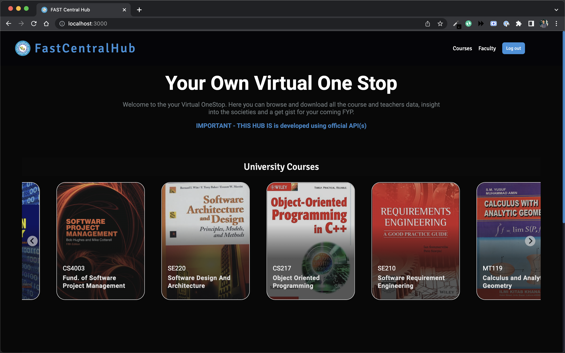
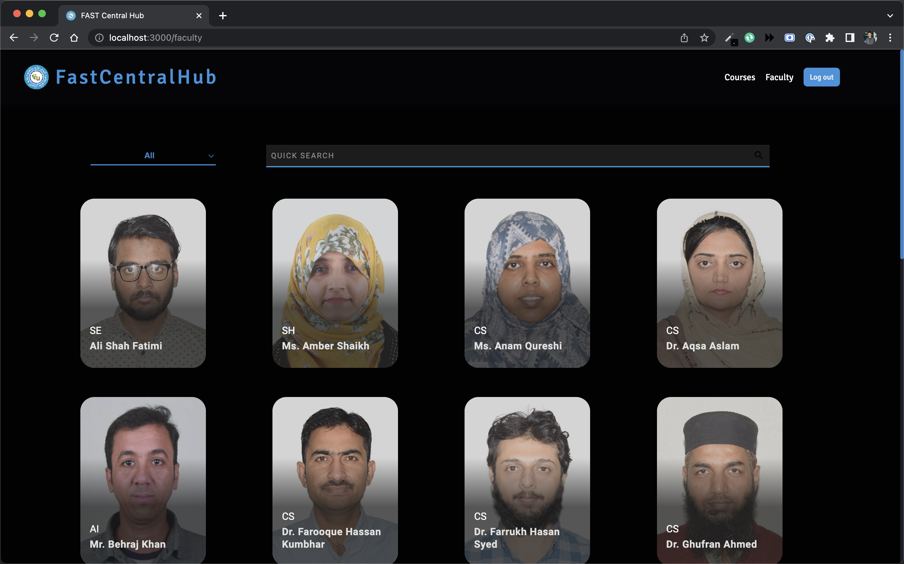
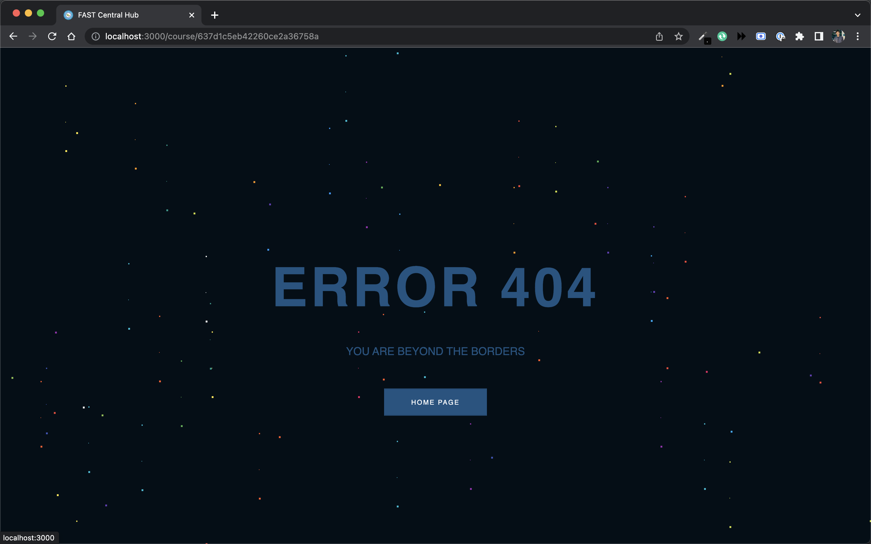
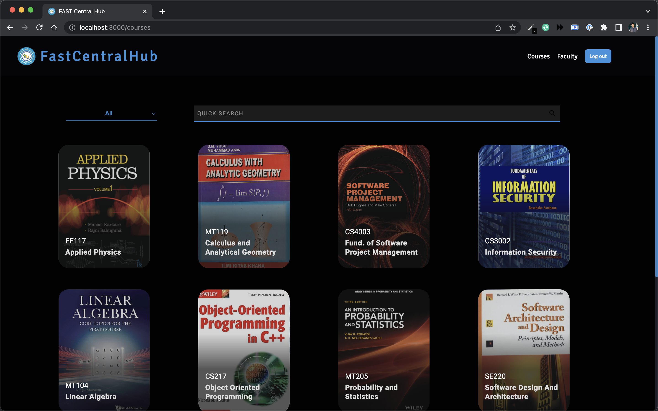
Client

Slide 5
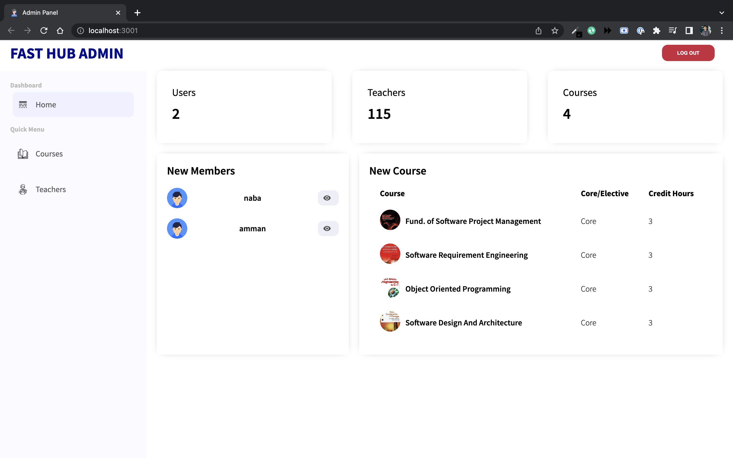
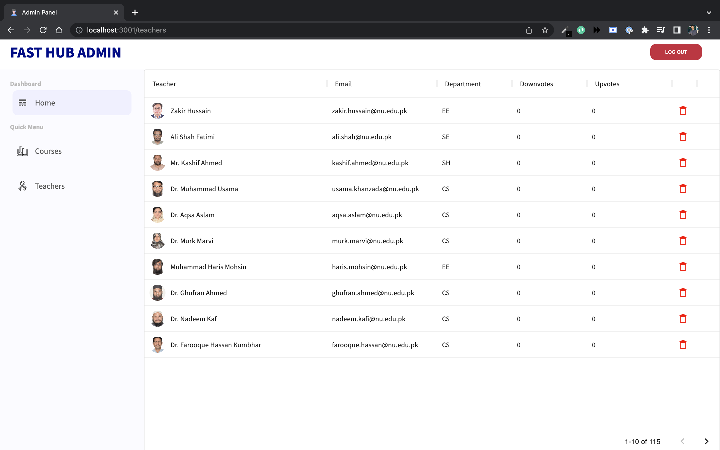
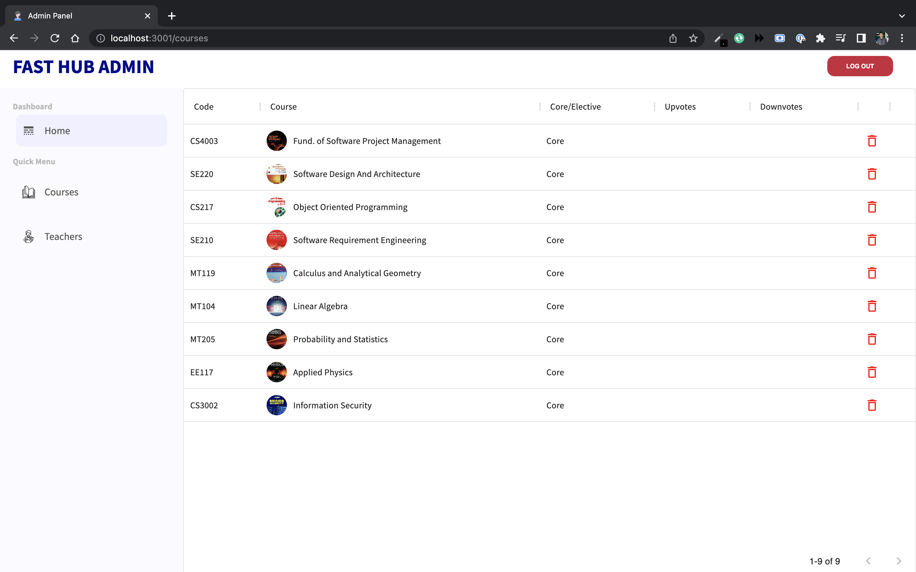
Admin

Slide 6
Work Done
30%
40%
40%
Client
Admin
Server

Slide 7
THANK YOU

